Slide 1

Real-Estate Pricing Predictors
Justin Grisanti

Slide 2
Objectives
Obtain a Business Understanding
Understand the Data
Prepare Data for Modeling
Create Models
Generate Regression Results

Slide 3
Business Understanding
Stakeholders:
Home Improve Inc.
Homeowners
Home buyers
Real-Estate Agents
Business Problem:
To help customers understand and improve the value of their home
Predictive and Inferential Model

Slide 4
Data Understanding
Homes in Kings County, Washington
Important Housing Information:
Price
Bedrooms
Sq Feet
Grade
Floors
Etc.

Slide 5
Data Preparation
Train and test data:
Remove outliers
Fill empty data
Check for erroneous data
Clean all columns to ensure better modeling

Slide 6
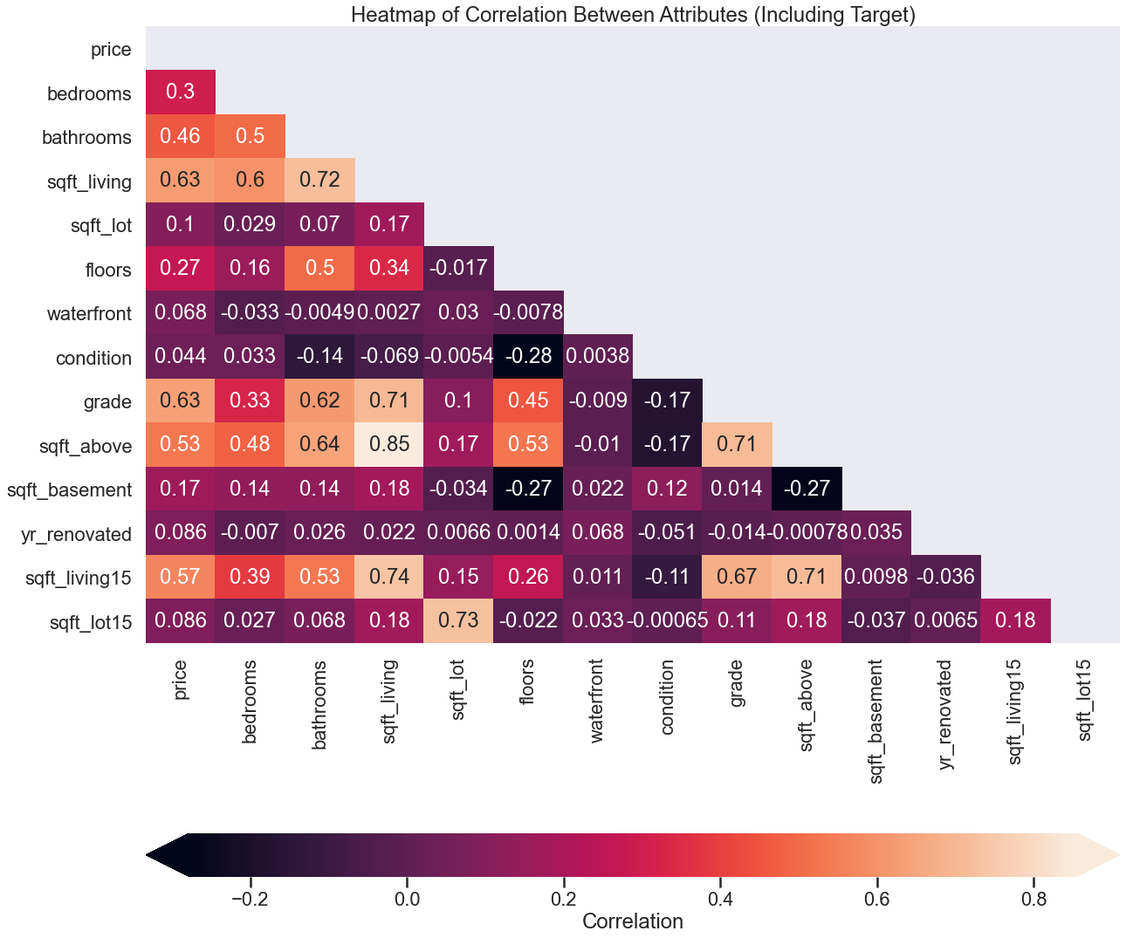
Modeling
What are the most correlated variables?
Grade & living space

Slide 7
Modeling
Baseline Model (Grade and Sq. Feet Living):
Train: 0.403
Validation: 0.400
Second Model (Numeric Fields):
Train: 0.488
Validation: 0.485
Final Model:
Train: 0.505
Validation: 0.498

Slide 8
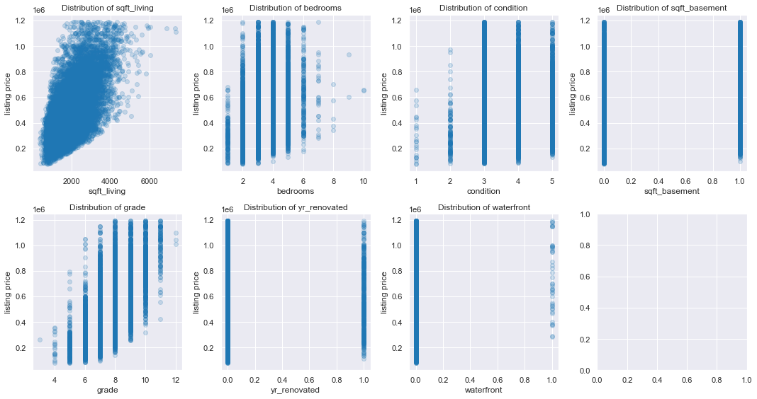
Final Model Attributes

Slide 9
Regression Statistics
Mean Absolute Error: $118k
Mean House Price: $481k
Coefficients:
Sq Feet Living Space: $98
Bedrooms: -$17,333
Condition: $45,169
Basement: $38,708
Grade: $88,275
Renovated: $102,962
Waterfront View: $242,268

Slide 10
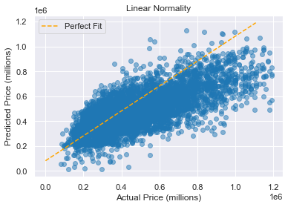
Normality Assumptions - Linearity
Normal trend with r^2 statistic of .51

Slide 11
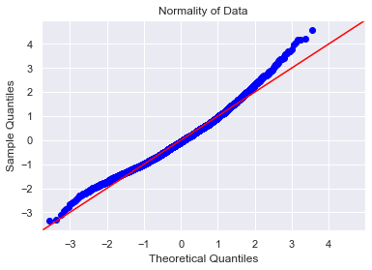
Normality Assumptions – Q-Q
Seems like a normal distribution, with few outliers at higher prices

Slide 12
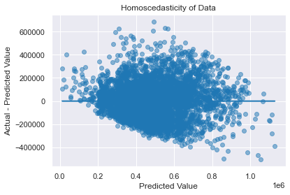
Homoscedasticity
Residuals seem even, however at higher prices the model tends to overpredict price
Notes:
Homo skid ass ticity

Slide 13
Next Steps – Improve Model
Add more features to model:
House color
Location
Proximity of Police Station
Add more data for higher priced houses

Slide 14
Thank you for your time!

